Slide 1


OCCULT OVARIAN METASTASES OF BREAST CANCER: 14 YEARS OF FOLLOW-UP IN A CANCER CENTER
Author: Ronniel Morais Albuquerque, M.D., PGY3
Co-authors: João Pedro Branco Santana, Wilker Dias Martins, Natália Biagioni de Lima, Cristina Anton, Renan Ribeiro e Ribeiro

Slide 2

Conflicts of Interest Statement
The authors have no conflicts of interest to declare.
Exigência da RDC Nº 96/08 da ANVISA

Slide 3
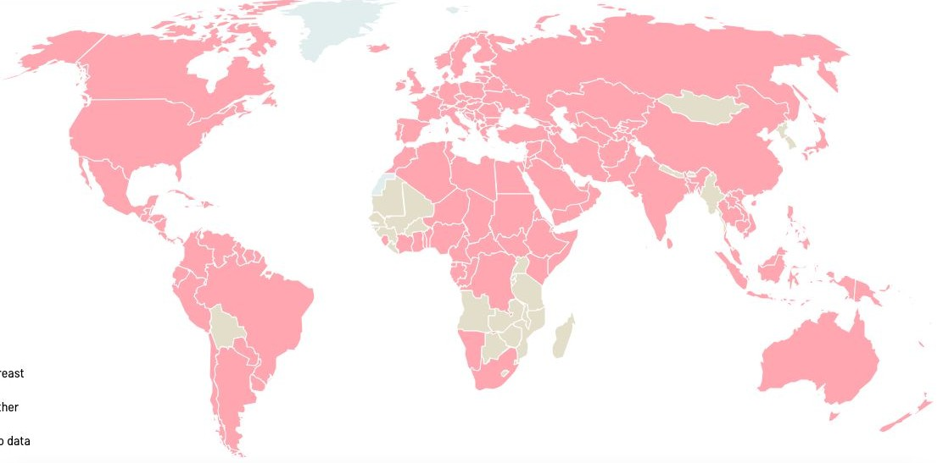
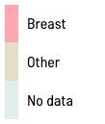
Introduction
Breast cancer is the most common cancer among women worldwide.
(Ferlay J, Ervik M, Lam F, et al. Global Cancer Observatory: Cancer Today. Lyon, France: IARC.)

Slide 4
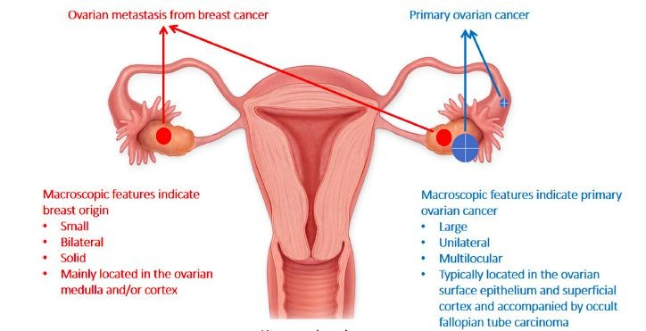
Introduction
Breast cancer is the most common cancer among women worldwide.
Ovarian metastasis from breast cancer are associated with poor prognosis, and is a challenging diagnosis preoperative due to the lack of early clinical and radiological manifestations.
(Tian, W., Zhou, Y., Wu, M. et al. 2019).

Slide 5
Objectives
We aimed to evaluate clinicopathological and radiological characteristics of metastatic breast tumors in salpingo-oophorectomies performed for hormonal suppression treatment.

Slide 6


Methodology
A retrospective analysis of 295 patients with breast cancer who underwent salpingo-oophorectomy (therapeutic) at a Brazilian cancer center between 2009 and 2023 was performed.
2009
2023
1
2
Clinicopathologic information:
Breast cancer characteristics
Preoperative ovary imaging results
Presence of ovarian metastases
Survival status:
- Outcomes were compared using Kaplan-Meier survival analysis.

Slide 7
Results
295
patients with breast cancer who salpingo-oophorectomy between 2009 and 2023.
underwent
Mean age at breast cancer diagnosis | 37 yo
Mean age at ovary metastasis diagnosis | 40 yo
20.3% patients had ovarian metastases from breast cancer (n=60).

Slide 8
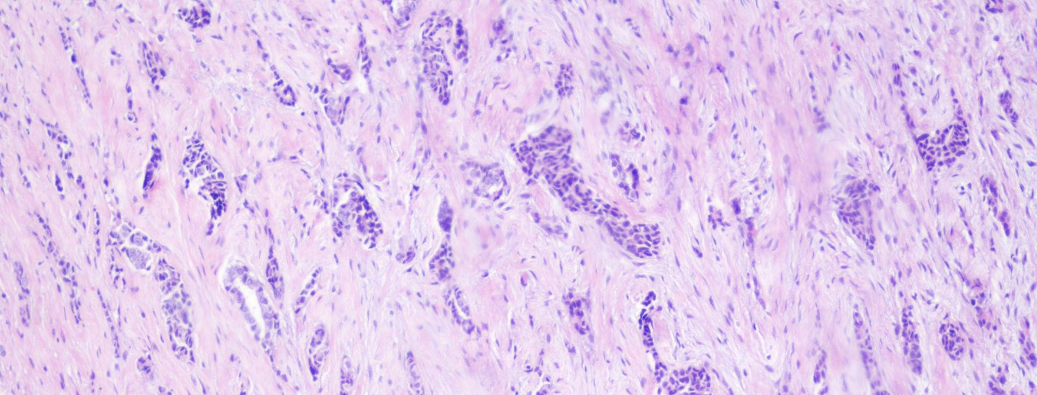
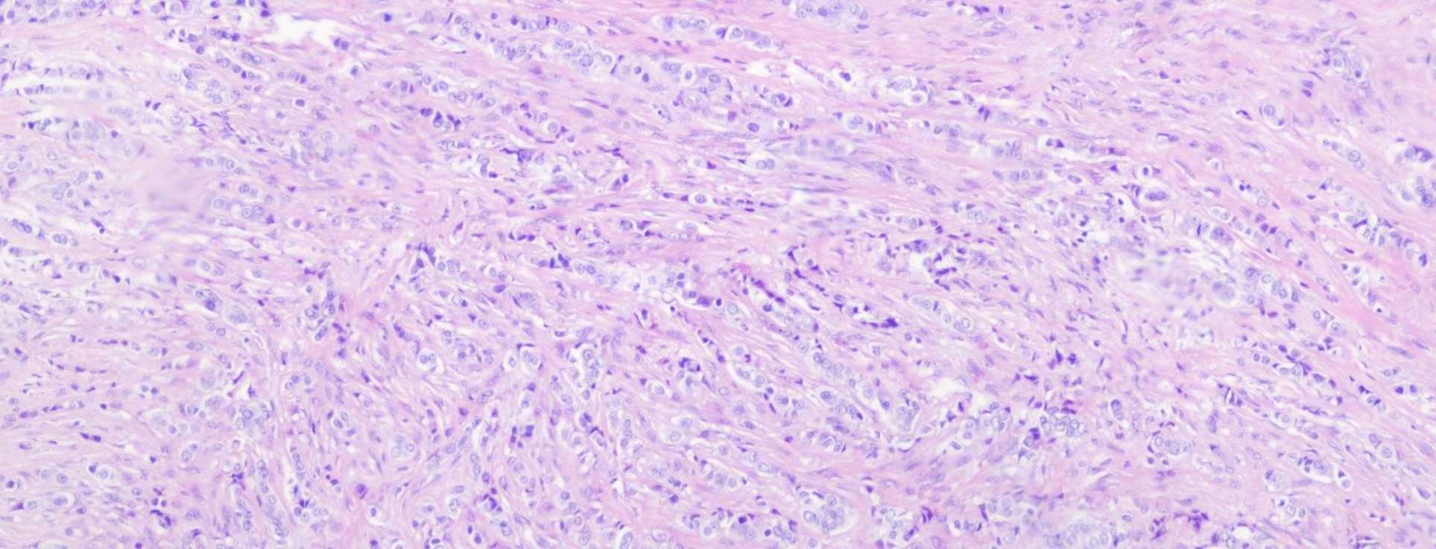
Results
The most common histologic type was carcinoma of no special type.
Histopathologic characteristics at breast cancer diagnostic
Histological type
Invasive ductal carcinoma |  | 45 (75%)
Invasive lobular carcinoma |  | 12 (20%)
Mixed |  | 3 (5%)
Molecular subtypes
Estrogen receptor
 | Positive | 60 (100%)
 | Negative | 0
Progesterone receptor
 | Positive | 54 (90%)
 | Negative | 5 (8,3%)
 | No data | 1 (1,7%)
HER-2 receptor
 | Positive | 3 (5%)
 | Negative | 57 (95%)
 | CDI
 | CLI

Slide 9
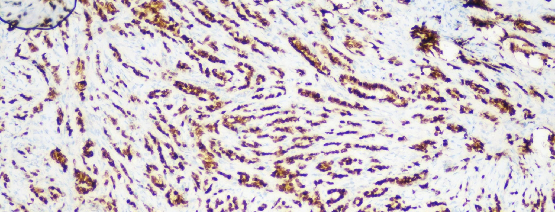
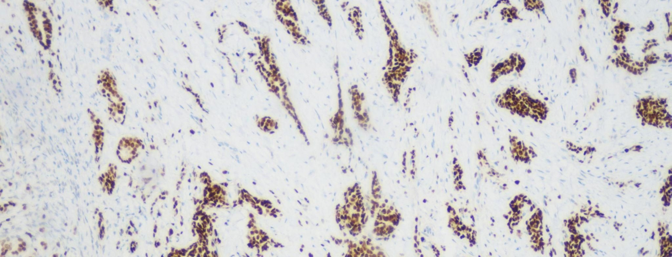
Results
The most common histologic type was carcinoma of no special type.
GATA3
Molecular subtypes
Luminal A | 11 (18,3%)
Luminal B | 39 (65%)
HER-2 | 3 (5%)
Triple negative | 0
Unclassifiable | 7 (11,7%)
ER
CLI

Slide 10
Results
Most patients with ovarian metastases had advanced tumor stage at breast diagnosis.
T
 | T1 | 6
 | T2 | 17
 | T3 | 17
 | T4 | 17
 | No data | 3
N
 | N0 | 3
 | N1 | 26
 | N2 | 19
 | N3 | 7
 | No data | 5
M
 | M0 | 2
 | M1 | 32
 | No data | 26
Stage at breast cancer diagnostic
Anatomic Stage
I | 0
IIA | 4 (6,7%)
IIB | 8 (13,3%)
IIIA | 9 (15%)
IIIB | 4 (6,7%)
IIIC | 3 (5%)
IV | 32 (53,3 %)

Slide 11
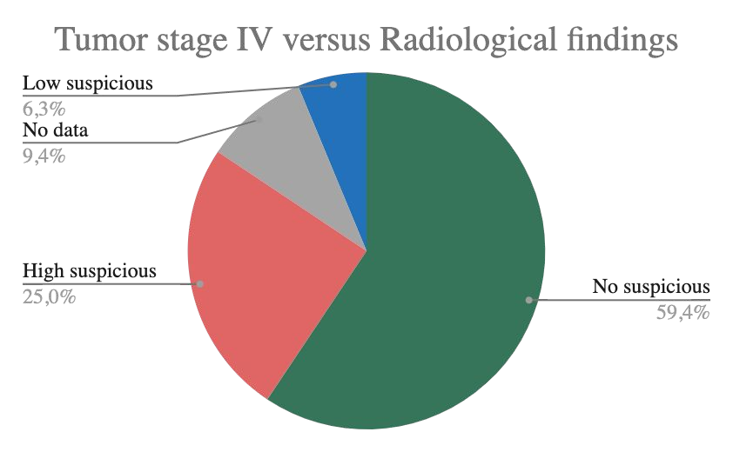
Results
Pre salpingo-oophorectomy imaging was done in the majority of patients (95%, n = 57).
59.6%
had no suspicious radiological findings on preoperative transvaginal/pelvic examination.
Radiological pre salpingo-oophorectomy findings
No suspicious radiological findings | 34 (59,6%)
Low suspicious radiological findings | 8 (14,1%)
High suspicious radiological findings | 15 (26.3%)
No data | 3

Slide 12
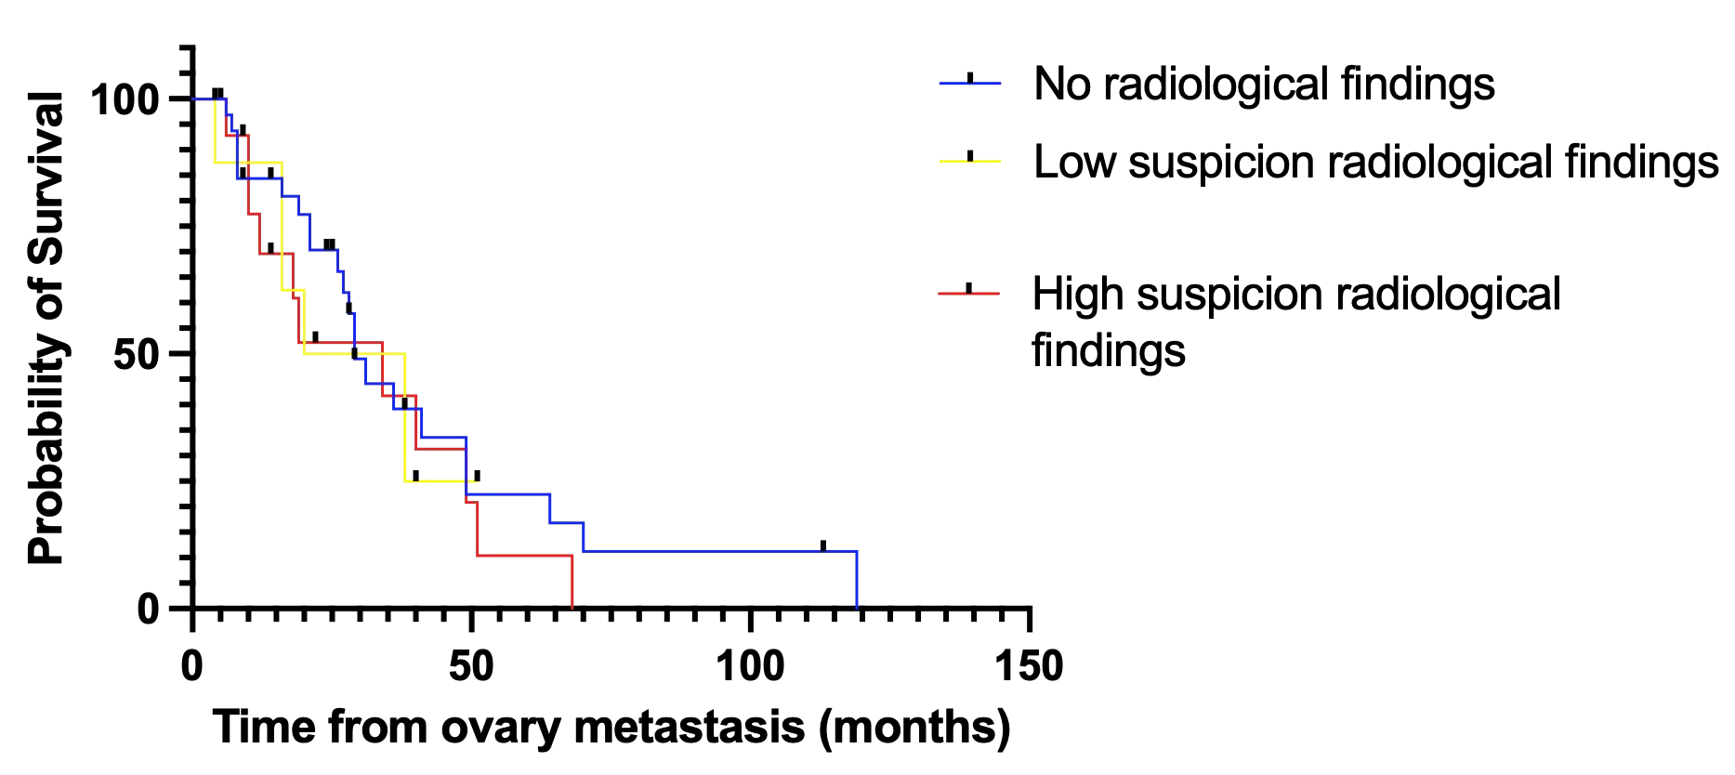
Results
The mean follow-up time was 111 months.
The mean survival rate after discovery of ovarian metastases was 28 months.
OS did not significantly correlate with preoperative imaging findings.

Slide 13

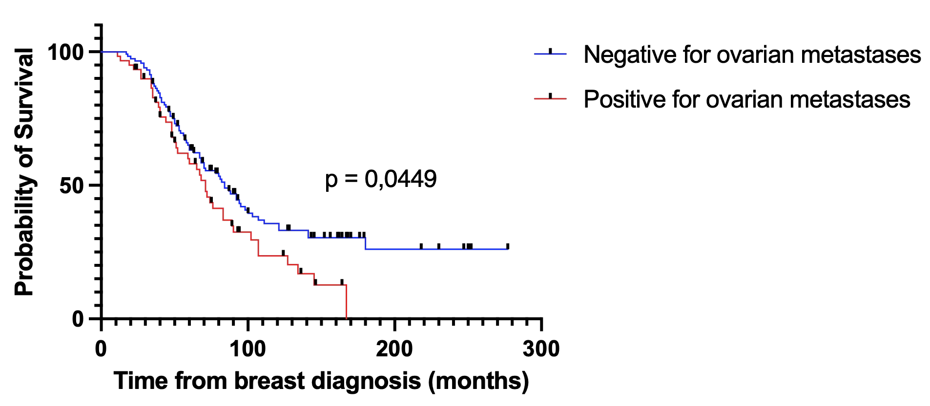
Preliminary data
84 mo
71 mo

Slide 14
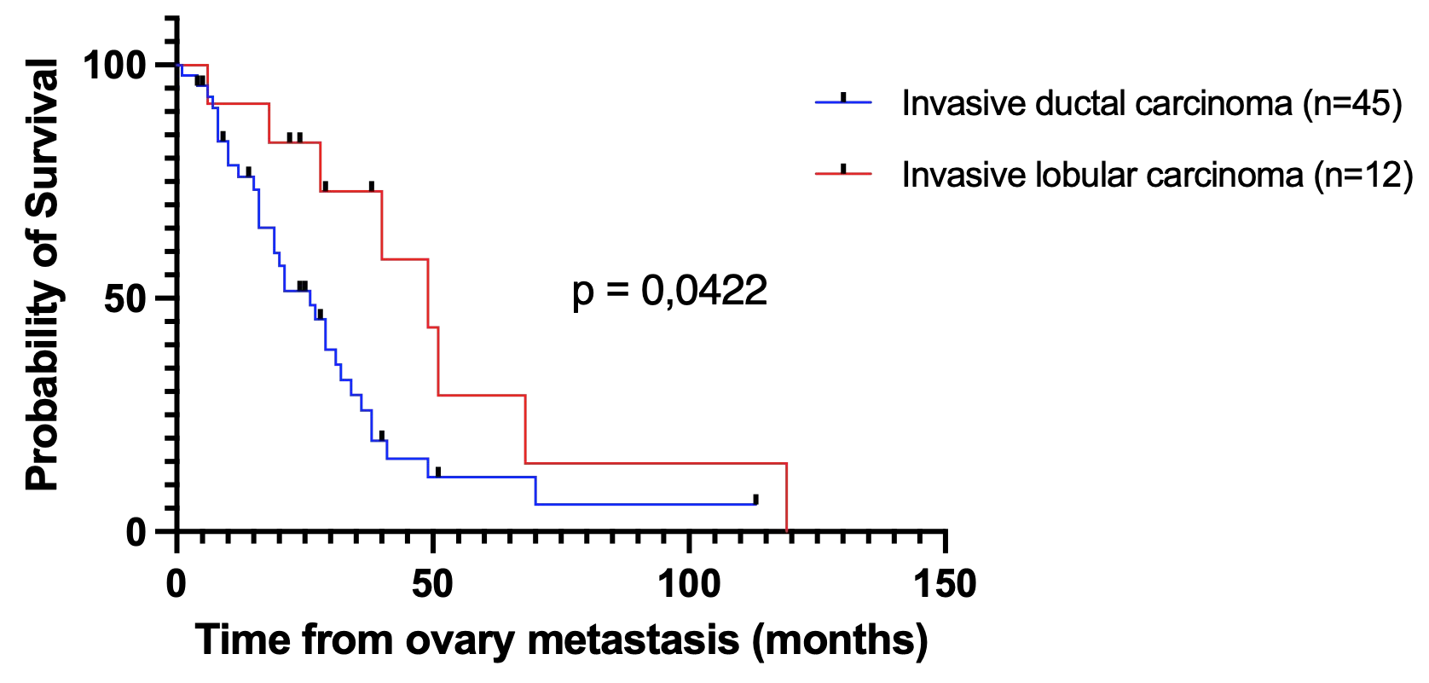
Results
Patients with ductal carcinoma had shorter overall survival (OS) after ovarian metastases detection.

Slide 15
Conclusions
Ovarian metastases from breast cancer were found in 20,3% of patients who underwent salpingo-oophorectomy for hormonal suppression;
  Incidence of ovarian metastases in breast cancer patients is variable in studies (13–47%);
Eid R. et al. (2019) | n = 13
Cerkauskaite D. et al. (2021) | n = 24
Pimentel C. et al. (2016) | n = 28
Bigorie V. et al. (2010) | n = 29
Inge T. et al. (2017) | n = 63 *
Bias: series of therapeutic salpingo-oophorectomy for hormonal suppression select young patients, pre-menopausal and most often in advanced disease;

Slide 16
Conclusions
Patients with primary stage IV breast cancer are more susceptible to ovarian metastases;
Ovarian metastases from breast were more frequently ductal carcinoma, which was associated with shorter overall survival when compared to lobular carcinoma;
  Controversial data in the literature -> heterogeneous groups evaluated
The majority of ovarian metastases were occult to radiological examination, being detected solely after pathologic examination of surgical specimens;
  Metastases from breast cancer are generally small / microscopic;
  Radiological examination may not exclude ovarian involvement;

Slide 17
Conclusions
Preoperative imaging findings did not significantly correlate with overall survival;
Preliminary comparative analysis: patients with histologically confirmed ovarian metastasis had a shorter overall survival when compared with those without ovarian involvement (84 x 71 months).

Slide 18
References
Ferlay J, Ervik M, Lam F, et al. Global Cancer Observatory: Cancer Today. Lyon, France: IARC. https://gco.iarc.fr/today/en
Tian W, Zhou Y, Wu M, et al. Ovarian metastasis from breast cancer: a comprehensive review. Clin Transl Oncol 21, 819–827 (2019). https://doi.org/10.1007/s12094-018-02007-5. Pimentel C, Becquet M, Lavoue V, Henno S, Leveque J, Ouldamer L. Ovarian Metastases from Breast Cancer: A Series of 28 Cases. Anticancer Res. 2016;36(8):4195-4200.
Eid R, Abdo M, Zgheib G, et al. Ovarian metastases from breast cancer: series over a 20-years period at a lebanese tertiary care centerInternational Journal of Gynecologic Cancer 2019;29:A118-A119.
Cerkauskaite D, Zilinskas K, Varnelis P, Oreibi ME, Asejev V, Dulskas A. Ovarian metastases from breast cancer: A report of 24 cases. J Gynecol Obstet Hum Reprod. 2021 Jun;50(6):102075. doi: 10.1016/j.jogoh.2021.102075. Epub 2021 Jan 28. PMID: 33515851.
Bigorie V, Morice P, Duvillard P, Antoine M, Cortez A, Flejou JF, Uzan S, Darai E, Barranger E. Ovarian metastases from breast cancer: report of 29 cases. Cancer. 2010 Feb 15;116(4):799-804. doi: 10.1002/cncr.24807. PMID: 20041486.
Peters IT, van Zwet EW, Smit VT, Liefers GJ, Kuppen PJ, Hilders CG, Trimbos JB. Prevalence and Risk Factors of Ovarian Metastases in Breast Cancer Patients < 41 Years of Age in the Netherlands: A Nationwide Retrospective Cohort Study. PLoS One. 2017 Jan 26;12(1):e0168277. doi: 10.1371/journal.pone.0168277. PMID: 28125710; PMCID: PMC5268771.
Tserkezoglou A, Kontou S, Hadjieleftheriou G, Apostolikas N, Vassilomanolakis M, Sikiotis K, et al. Primary and metastatic ovarian cancer in patients with prior breast carcinoma. Pre-operative markers and treatment results. Anticancer Res. 2006;26(3B):2339–4
Gagnon Y, Têtu B. Ovarian metastases of breast carcinoma. A clinicopathologic study of 59 cases. Cancer. 1989 Aug 15;64(4):892-8. doi: 10.1002/1097-0142(19890815)64:4<892::aid-cncr2820640422>3.0.co;2-c. PMID: 2743281.

Slide 19




Thank you!
Ronniel Morais Albuquerque, M.D., PGY3 ronniel.albuquerque@hc.fm.usp.br

